Slide 1

UNIVERSITY OF PETROLEUM & ENERGY STUDIES
School of Computer Science
Dehradun
COURSE: IT Security
July – December 2023
Delivered by
Dr. Gopal Singh Rawat
1

Slide 2
Course Plan
Introduction to IT System Security
Operating System Security
Endpoint Security
Application Server Security
Database Server Security
IT System Security Processes

Slide 3
Unit #1: Introduction to IT System Security

Slide 4
1.1 What is IT System Security:
This covers everything from prevention, detection and response to improper access from within & outside an organization, to protect information and systems
Importance of IT Systems Volume, Ways and Types of attack
Targeted attack → Internal Fraud and Security risks
IT Systems need to be defended
1.2 Elements of IT System Security:
Vulnerability
Threat
Risk
Exposure
Countermeasure/Safeguard
Relation Between the Security Elements

Slide 5
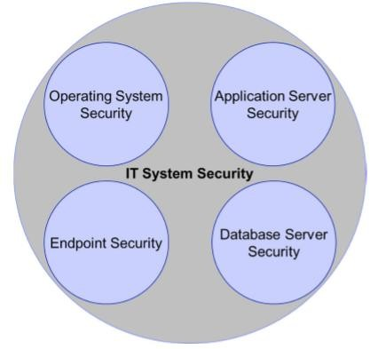
1.3 IT System Security involves:

Slide 6
1.4 Technical Controls for IT System Security:
For Identification and Authentication for an Authorized User:
Based on Something the Authorized User Knows → User ID/Password, Secret Question’s answers
Based on Something the Authorized User Possesses (has) → Access Cards, Keys, Mobile for OTP
Based on Something the Authorized User IS (physical) → Biometrics, Retina, Fingerprints
Logical Access Control:
Access criteria → Passwords, Access Control Lists, Encryption
Policy → Memory and Smart Card Tokens for specific access to restricted areas
Technical / Admin / Management of Access Controls
Cryptography:
Keys → Secret, Public, Hybrid
Usage → Data Encryption, Integrity, eSignatures, User Authentication (Web Apps/Portals)

Slide 7
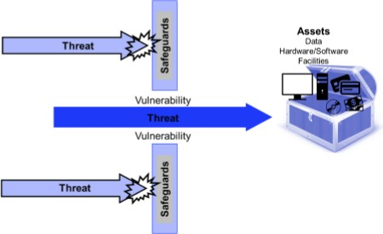
1.5 IT System Security: Vulnerabilities, Threats & Assets
Vulnerability: State of being exposed to the possibility of being attacked or harmed, either physically or emotionally.
Threat: Intention to inflict pain, injury, damage, or other hostile action on someone in retribution for something done or not done. Person / Thing is likely to cause damage or harm.

Slide 8
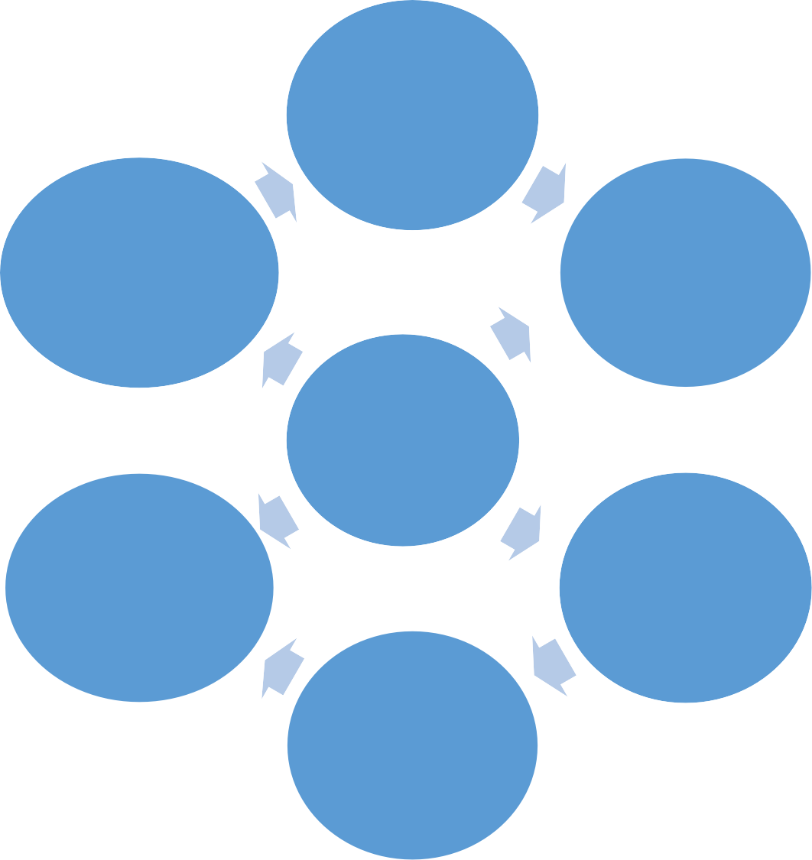
1.6 Risk Mitigation:
Selection and implementation of Security Controls
Selecting safeguards
Accept residual risk
Implementing controls and monitoring effectiveness
Interpreting the risk analysis results
Executive Level
Changes in existing and future risk
Mission Priority, Budget & Risk Appetite
Business Process
Implementation Progress
Framework Profile
Operational level

Slide 9
Example – IT Department
Identify Environment & Critical Assets
Threats Posed / Analysis
Implement Mitigation Controls
Threat Events Identification
Prioritize Business need
Vulnerability Analysis
Vulnerability Mitigation

